Slide 1
FIRE AND GAS LEAK DETECTION SYSTEM USING IoT
Project Supervisor
Salma Parvin
Lecturer
Dept. of CSE
Dhaka City College
Farzana Laboni
Roll:37
Regi no: 14502000552
Session: 2014-15
Esmat Ara Elona
Roll:54
Regi no: 14502000435
Session:2014-15

Slide 2
Outline
Introduction
Objective
Existing System
Drawbacks of Existing System
Our Proposed System
Feature of Proposed System
Methodology
Requirements
Context Diagram
Flow Chart
Conclusion

Slide 3
Introduction
The device is intended for using in household safety where appliances and heaters that use natural gas and liquid petroleum gas (LPG) may be a source of risk. Therefore, we are proposing a system that will detect the gas leakage and to notify people through their smart devices via internet.

Slide 4
Objective
Identifying potentially hazardous gas leak by sensors.
In case of temperature increasing in surrounding, gives a hint of firing in advance by dint of temperature sensor.

Slide 5
Existing System
ADC was used to convert analog signal to digital.
It works offline; i.e no internet is necessary.
It alerts people by using a buzzer.
It is comparatively costly.
MQ-6
A\D converter
Micro controller
DC motor
Buzzer
Fig 1: Block diagram of an automated LPG gas leakage detector and control

Slide 6
Drawback of Existing System
If error signaling occurs in ADC converter then user may not be alarmed at the time of danger.
This system may face complexity while implementing.
This system is a long-time process.

Slide 7
Proposed System
Our proposed system detects gas leakage and also it will be able to alert people in time of firing. It reads current room temperature and humidity.
This system uses MQ-6 sensor that is highly sensitive to flammable gases and LPG and smoke or fire.
This proposed system consists of a device with a WiFi module.
This system uses a built-in software application for receiving data and notifying the users through SMS.
The system can be used for other applications in the industry or factory that depend on LPG and natural gas.

Slide 8
Our Project Feature
This system is reasonable and can be easily implemented; thus it is cost effective in respect of our country.
This system provides real-time monitoring of concentration of gases which is present in the atmosphere.
DHT11 sensor will be interfaced with nodemcu and show us the room temperature as well as humidity.
People of rural area also can afford this effective device.

Slide 9
Methodology
The two sensors (MQ-6 gas sensor & DHT11) are connected with the pins of nodemcu with jumper wires.
The sensors output is given to the AC-DC converter.
The sensors send its reading to the wifi module where the program is executed for checking the leak condition in Arduino IDE.
The module collects this reading from these two sensors.
This data goes to the server through the API (application programmable interface) via internet.

Slide 10
This data goes to the server through the API (application programmable interface) via internet.
The instructions are given to the application of respective users.
This system shows us the real time as the task is done in nanoseconds.

Slide 11
Requirement
Software requirement
1.1: Android application (Blynk)
1.2: Arduino IDE
2. Hardware requirement
2.1: Breadboard
2.2: ESP8266 nodemcu
2.3: MQ-6 gas sensor
2.4: DHT11 Module
2.5: Ywrobot breadboard power supply MB-V2

Slide 12
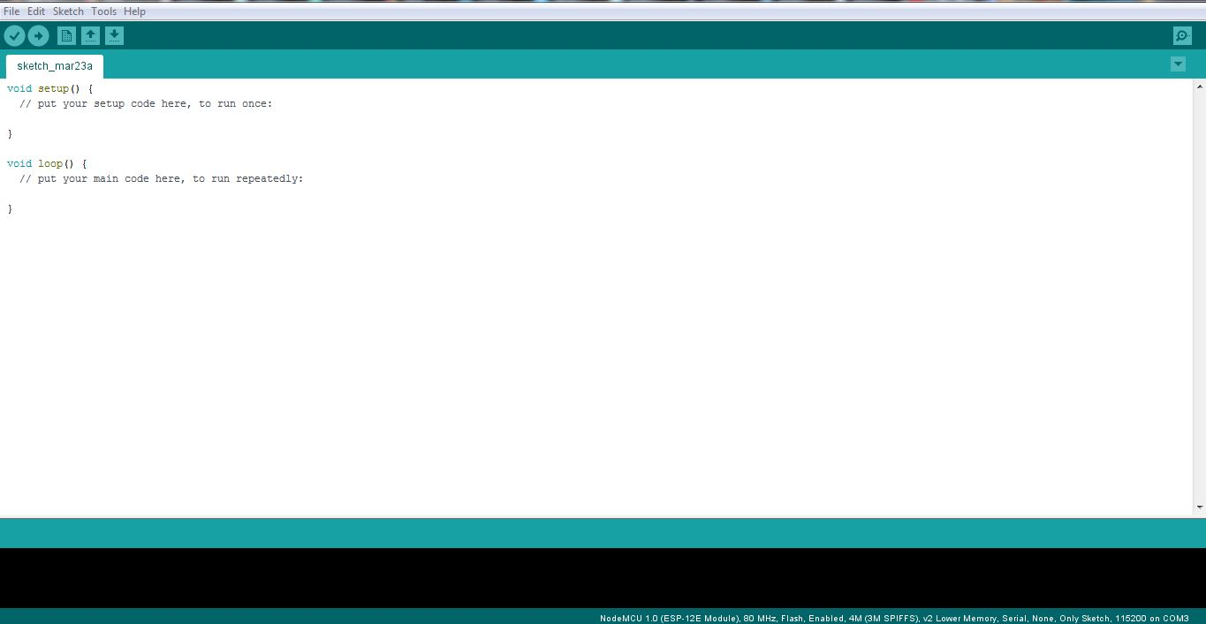
Arduino IDE
Arduino IDE is an open-source software to write code and upload it to the hardware.
Fig 1.1: Arduino IDE

Slide 13
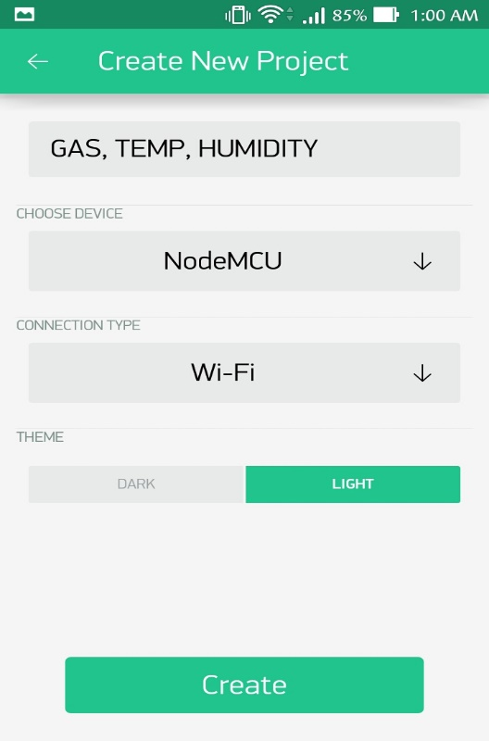
Blynk App
It is an internet of things platform which allows to control sensor data and control electronic appliances.
Fig 1.2: Creating project with selected hardware in blynk app

Slide 14
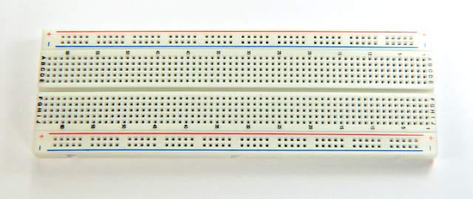
Breadboard
The first (top) and last (bottom) two rows of the breadboard consists of 5 holes in each column.
They are horizontally connected with each other internally.
Fig 2.1: Breadboard

Slide 15
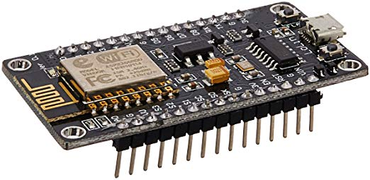
ESP8266 Nodemcu
it is a small device that handles 90% of the work-load.
It has built-in wifi.
It has built-it MCU (micro controller unit).
Fig 2.2: Nodemcu

Slide 16
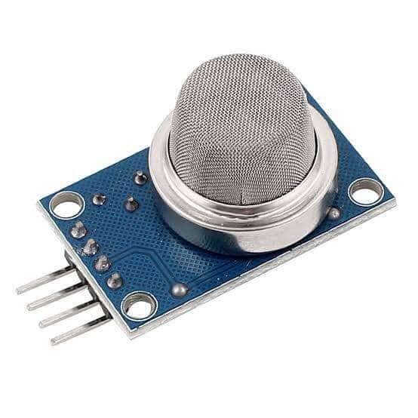
MQ-6 Gas Sensor
This sensor is sensitive to flame and smoke.
Sensitive to flammable gas such as-
LPG
Propane
Butane
Methane
Smoke
Fig 2.3: MQ-6

Slide 17
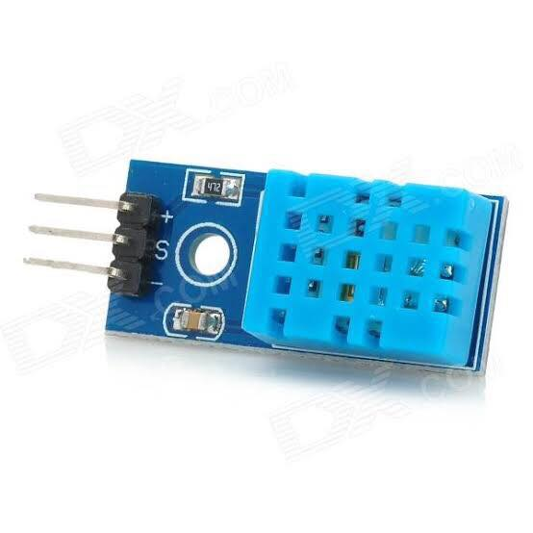
DHT11 module
It is low-cost.
It is a 3-pin module.
The DHT11 is a 4-pin (one pin is unused) temperature and humidity sensor capable of measuring 20% - 90% relative humidity and 0 to 50 °C.
Shows up data every 2 seconds.
Fig 2.4: DHT11

Slide 18
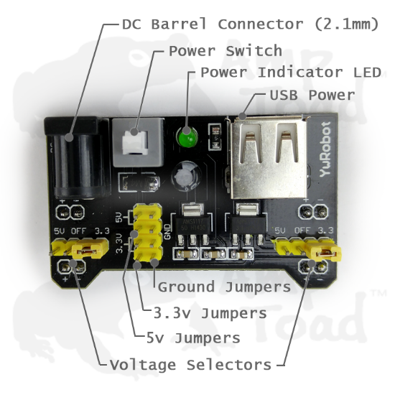
YwRobot MB-v2
There are two power supply ports on the left side, a DC port and a USB port.
On the right side, there are two ports of power output.
The USB port can supply only 5V.
Fig 2.5: Ywrobot MB-v2

Slide 19
Block Diagram
Power supply
IoT esp8266
LPG Gas
sensor
Temperature & humidity sensor
User android smart device
Arduino IDE
Fig 3.1: Block diagram of proposed system

Slide 20









Context Diagram
WiFi Router
Laptop with Blynk server installed
Message
API interface
Blynk cloud
IoT Module
Android phone with Blynk app
Blynk server handles data transfer between mobile app and selected hardware
Temp. & humidity sensor
Gas sensor
₊
Fig 3.2: Context diagram

Slide 21
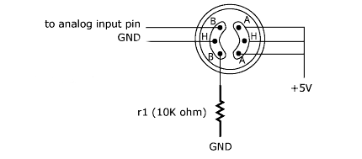
Circuit Diagram of MQ-6
Fig 3.3: Circuit diagram of MQ-6

Slide 22
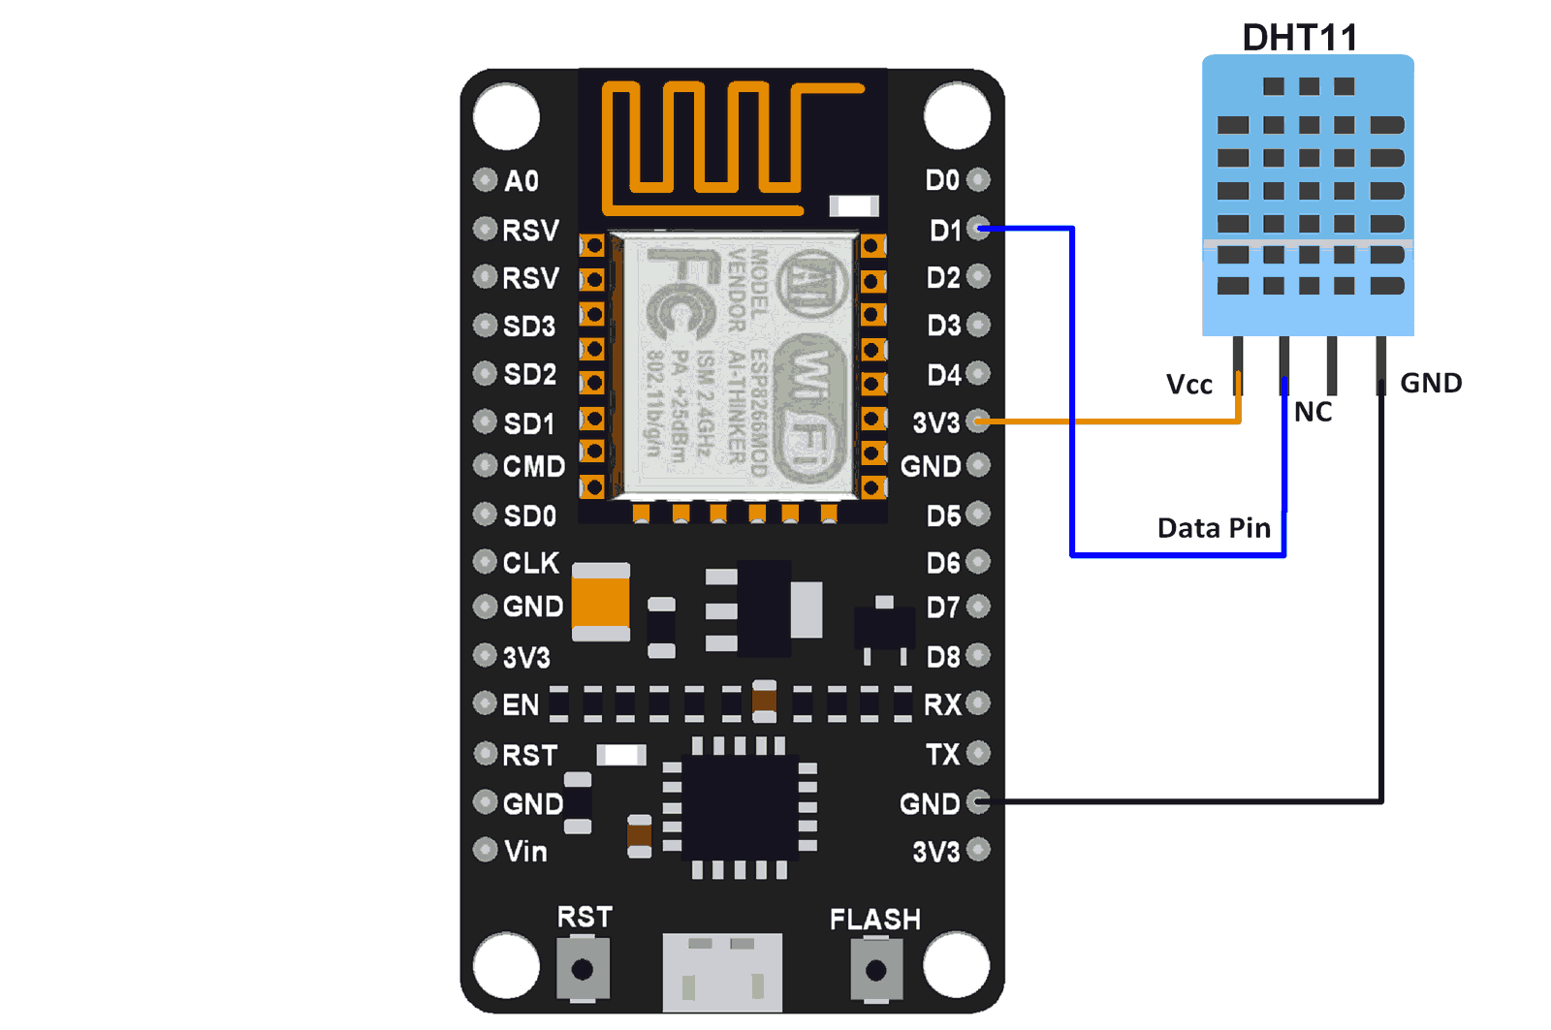
Circuit Diagram of DHT11
Fig 3.4: Circuit diagram of DHT11 module with nodemcu

Slide 23
Flow Chart
Start
Check for leakage
YES
Internet connection?
NO
Something went wrong
NO
Does LPG sensor sense any leakage?
YES
Send SMS from online
End
Fig 3.5: Flow chart of the system with MQ-6

Slide 24
Flow Chart
Start
NodeMCU
Internet connection
?
NO
YES
DHT11 data received?
NO
YES
Data
server
Fig 3.6: Flow chart of the system with DHT11 module

Slide 25
Conclusion
Fastest real-time monitoring is the key point of this proposed project. Reviewing of existing system of gas leakage detector, we emphasized on the fastest time response and correct measurement of temperature as soon as possible. This system is surely cost-effective with respect to our country than the existing one and easy to use. The proposed system shows up data every 2 seconds. However, the system must be designed and implemented carefully to avoid irrelevant result.

Slide 26
THANK YOU!

